Slide 1
https://rstudio.cloud/project/1793948

Slide 2
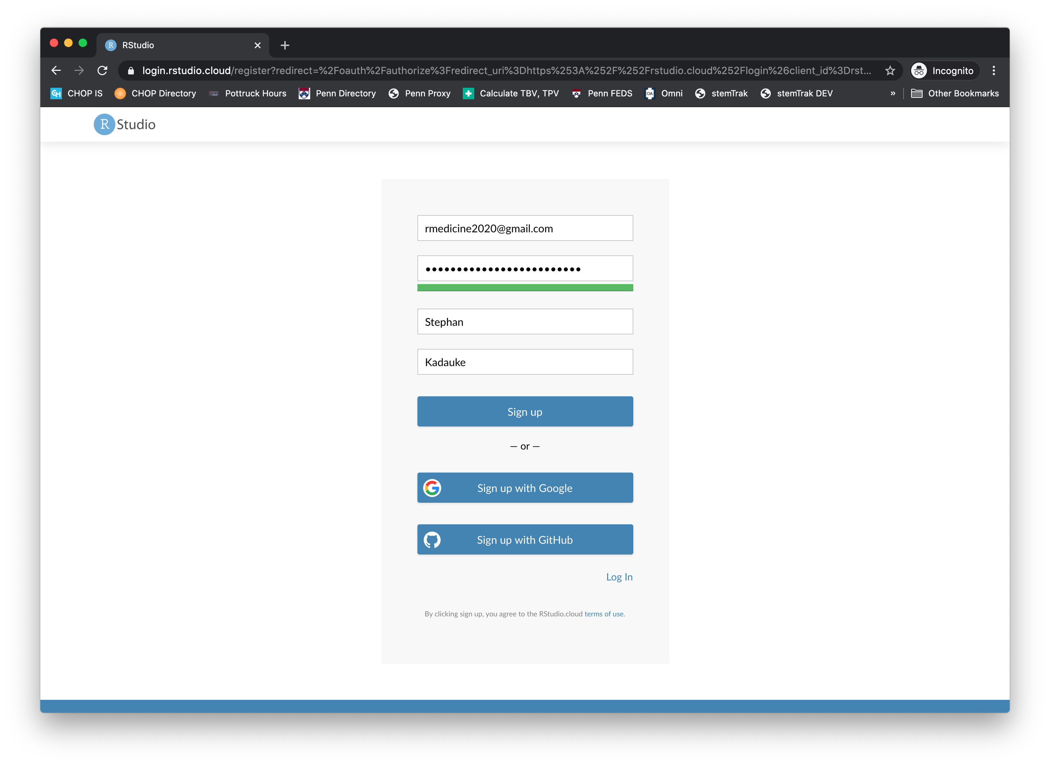

Slide 3
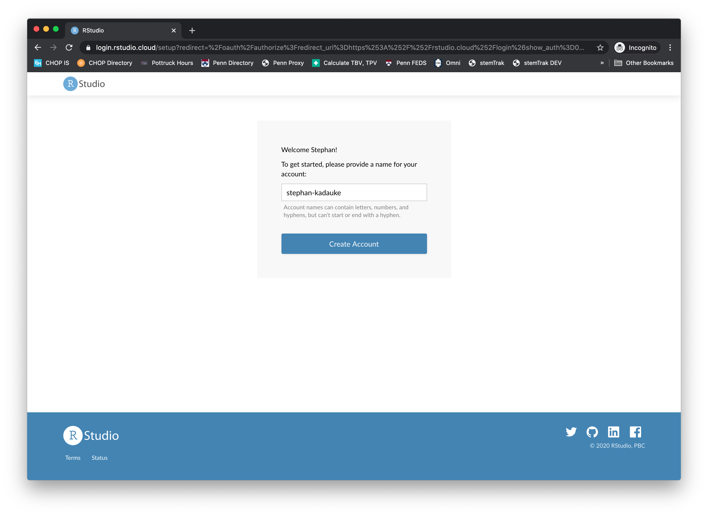

Slide 4
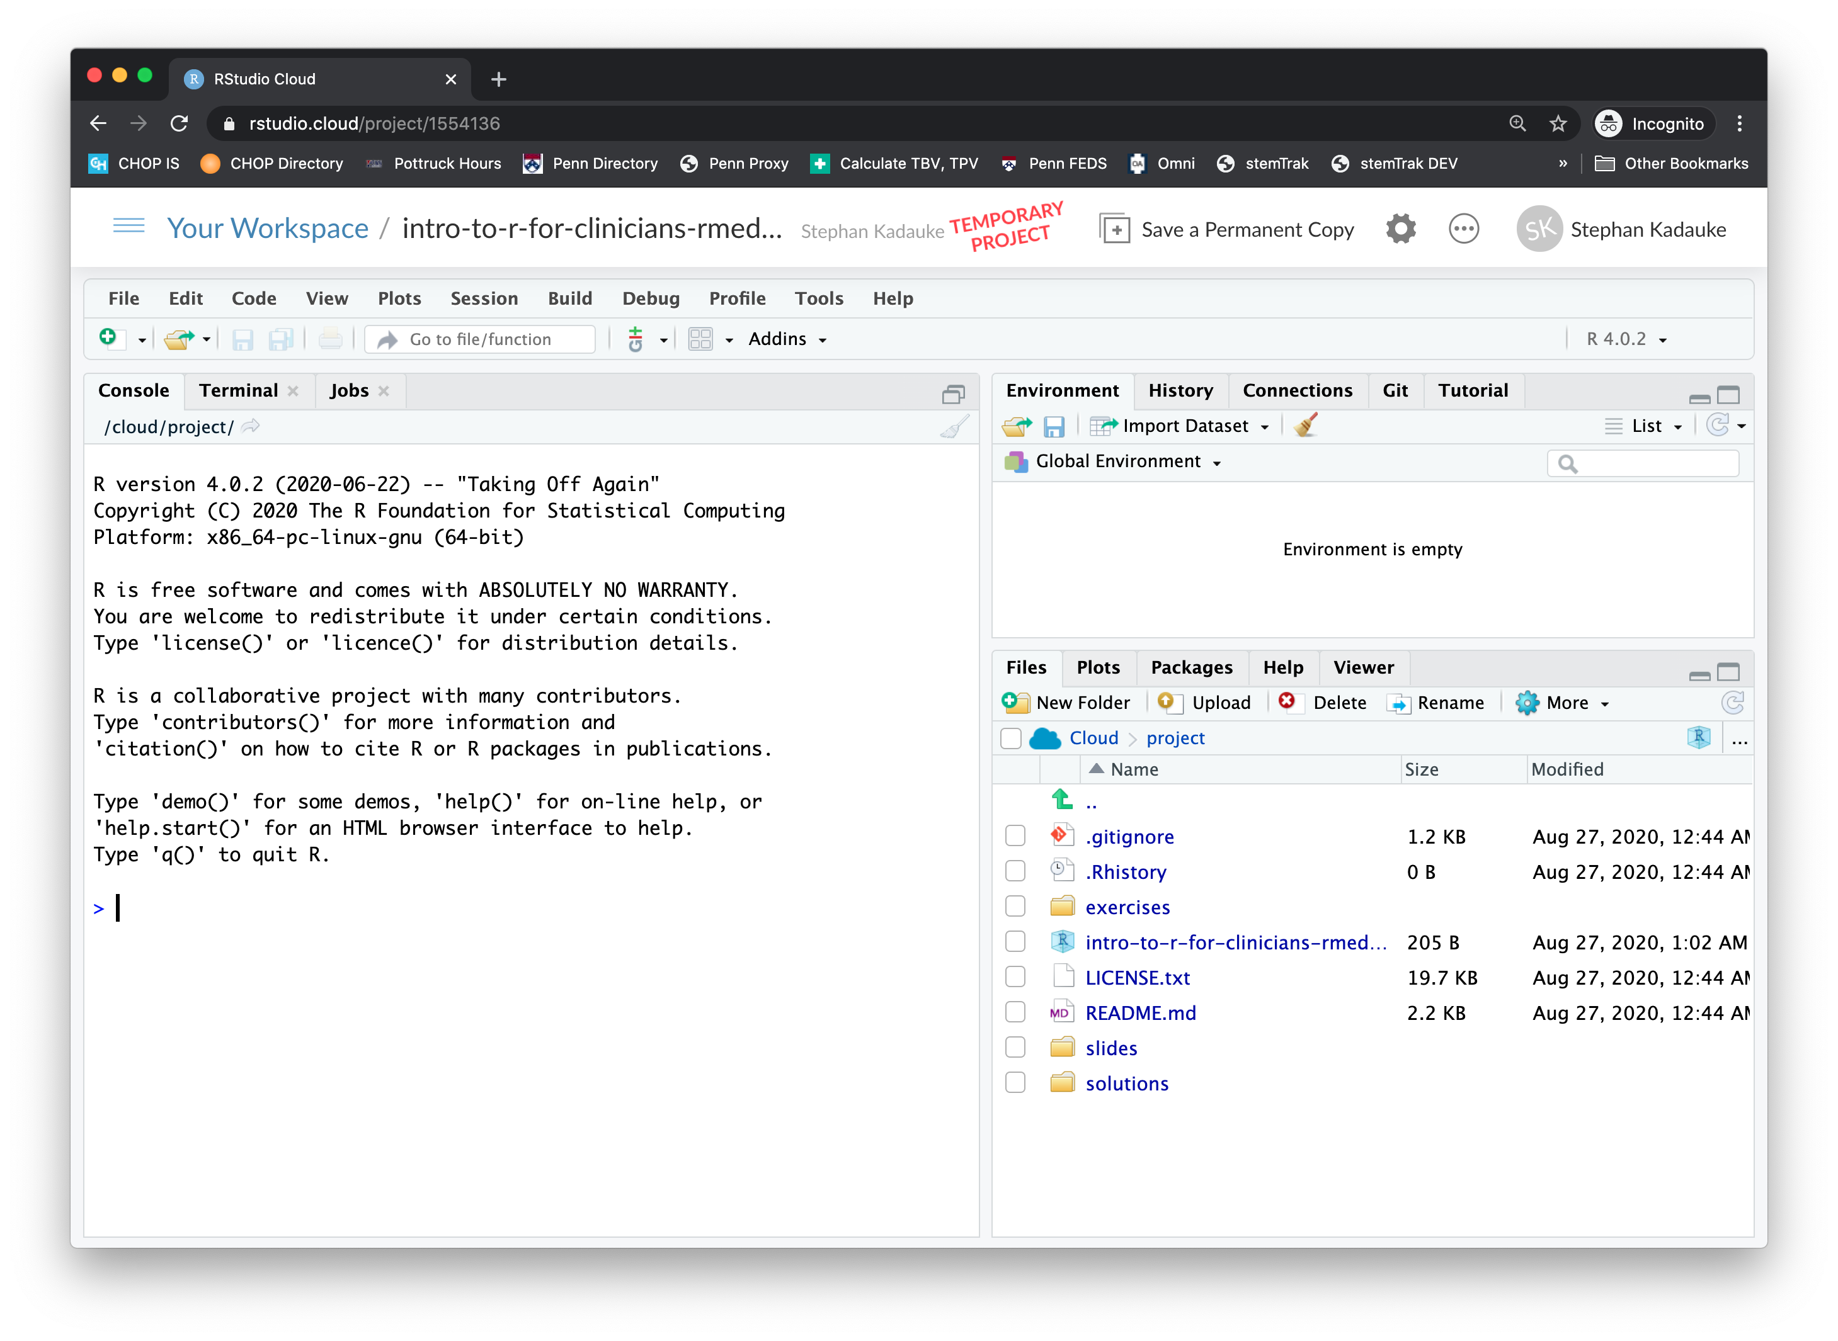

Slide 5
